Slide 1

Final Project
Tadeo Aguilar
Berenice Cedillo Mariana Revilla
Federico López

Slide 2
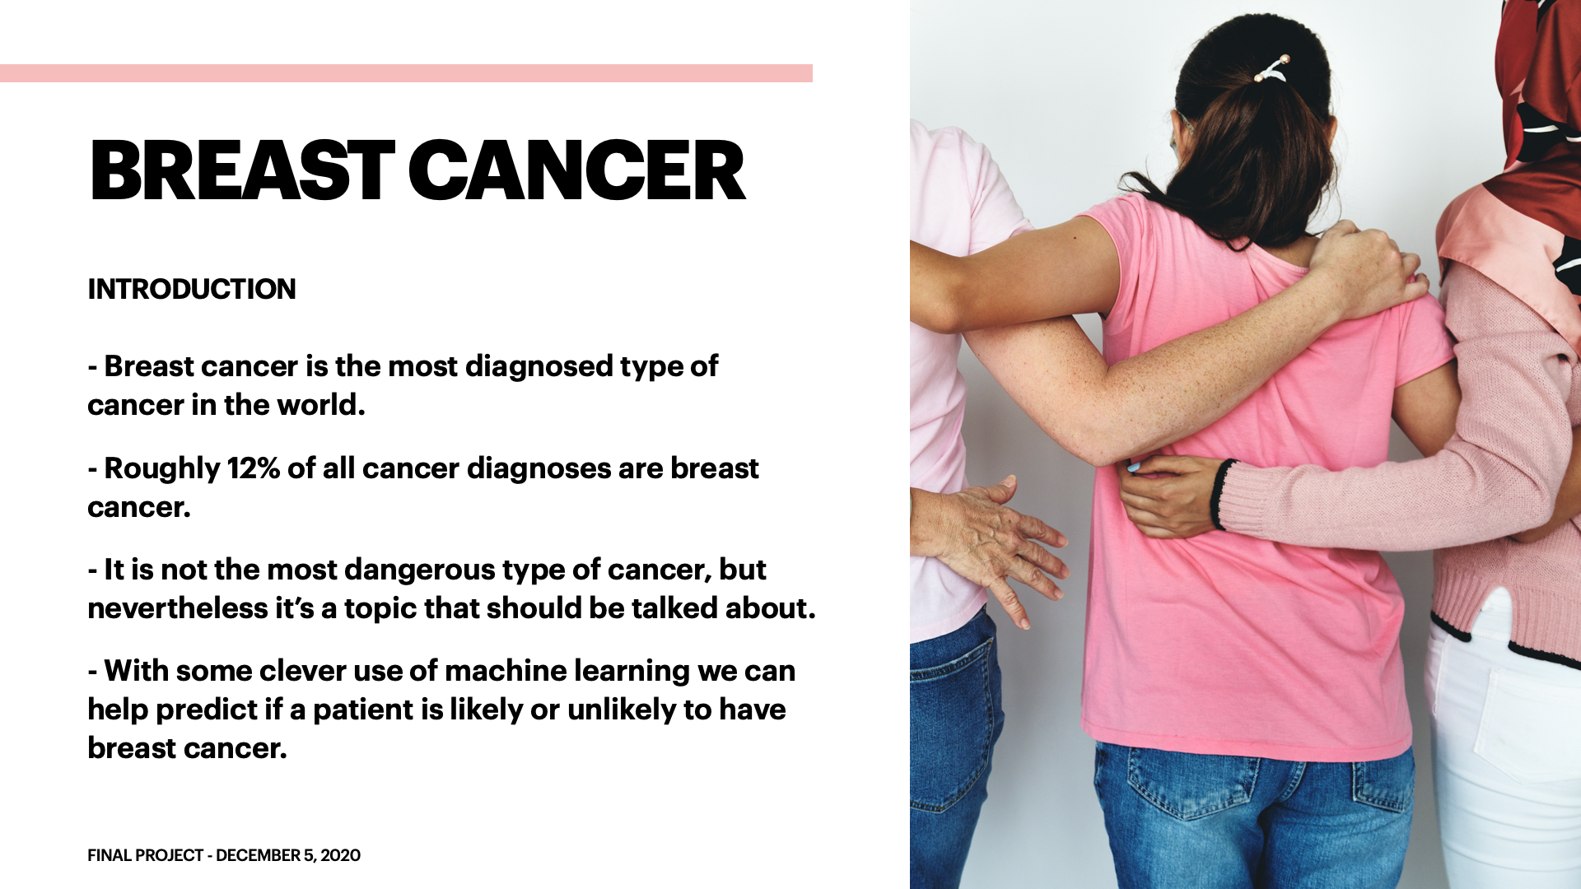
Introduction
Breast cancer is the most diagnosed type of cancer in the world.
Roughly 12% of all cancer diagnostics are breast cancer.
Luckily it's not the most dangerous type of cancer, but nevertheless it's a topic that should be talked about.
With some clever use of machine learning we can help predict if a patient is likely or unlikely to have breast cancer.

Slide 3
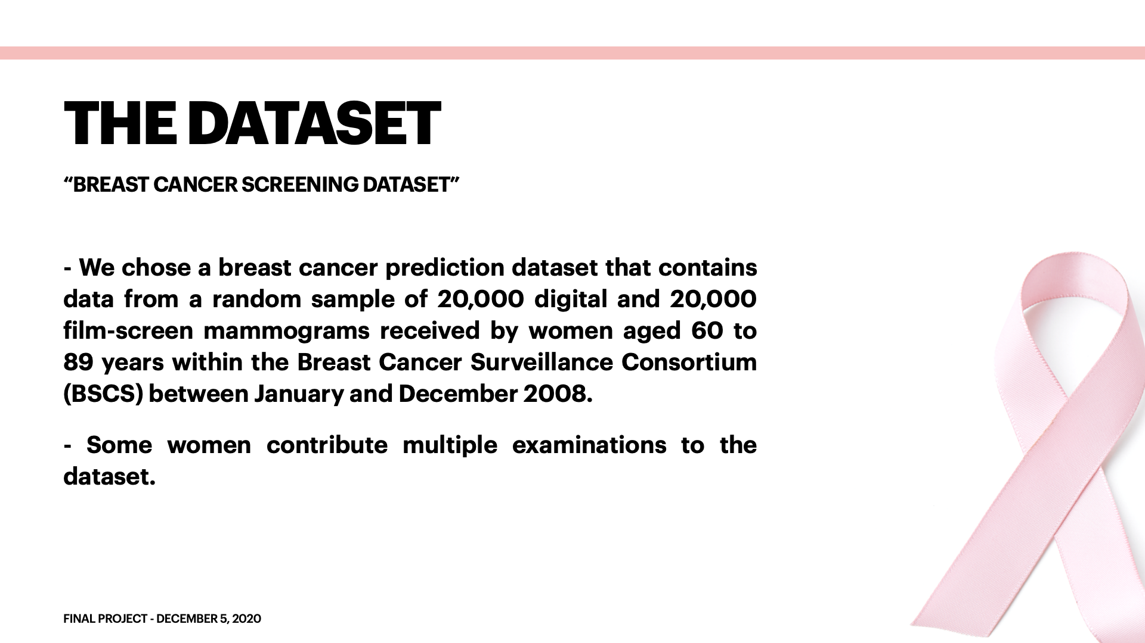
Dataset
We chose a Breast Cancer prediction dataset that contains data from a random sample of 20,000 digital and 20,000 film-screen mammograms received by women aged 60-89 years within the Breast Cancer Surveillance Consortium (BCSC) between January 2005 and December 2008.
Some women contribute multiple examinations to the dataset.
The dataset can be found here: https://www.kaggle.com/haithemhermessi/breast-cancer-screening-data-set

Slide 4
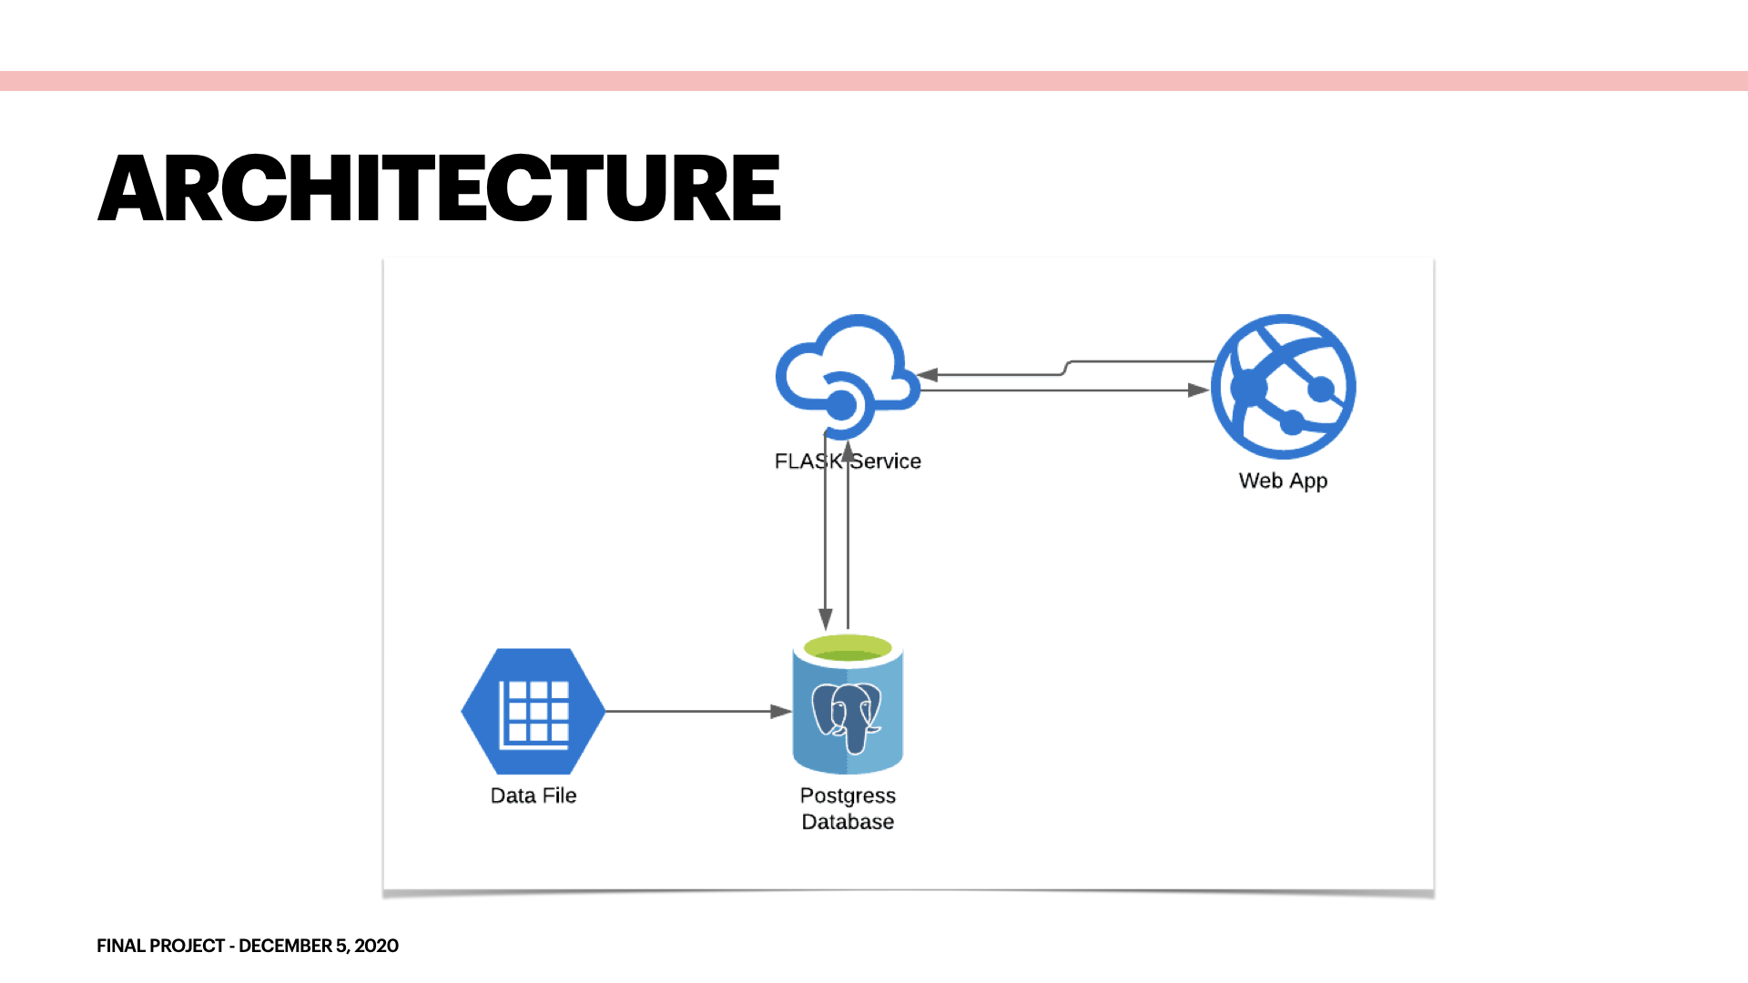
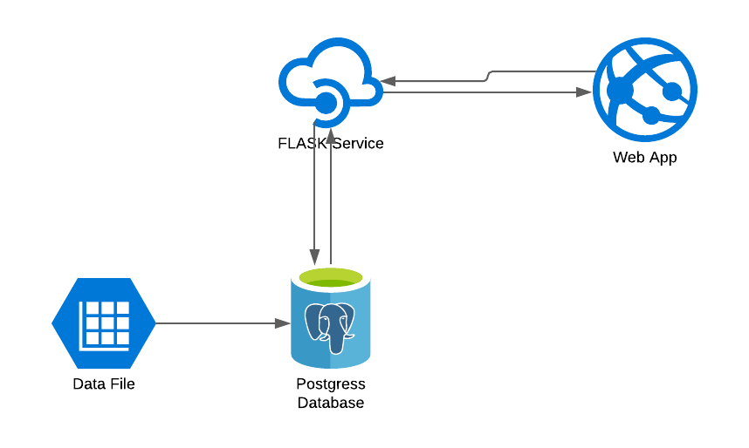
Architecture

Slide 5
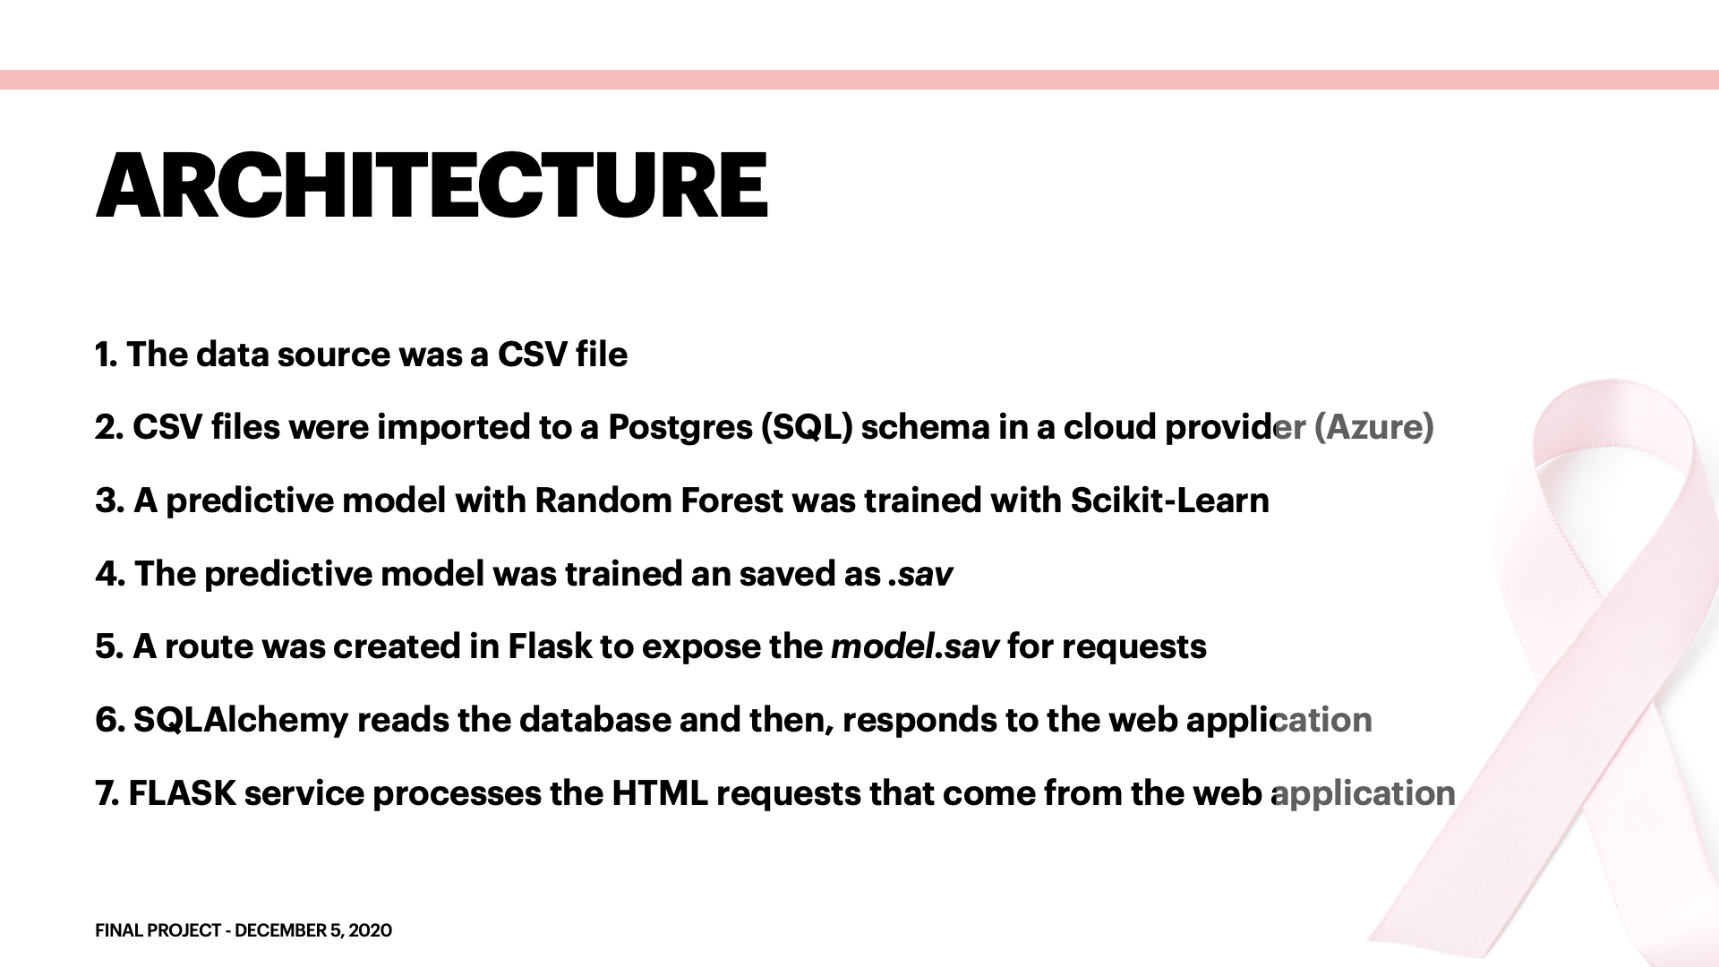
Architecture
The data source was a CSV file
CSV files were imported to a Postgres (SQL) schema in a cloud provider (Azure)
A predictive model with Random Forest was trained with Scikit-Learn
The predictive model was trained and then saved as .sav
A route was created in FLASK to expose the model.sav for requests
SQLAlchemy reads the database and then responds to the web application
FLASK Service processes the HTML requests that come from the web application.
The web application was built using HTML, CSS and Javascript for visualizations.

Slide 6
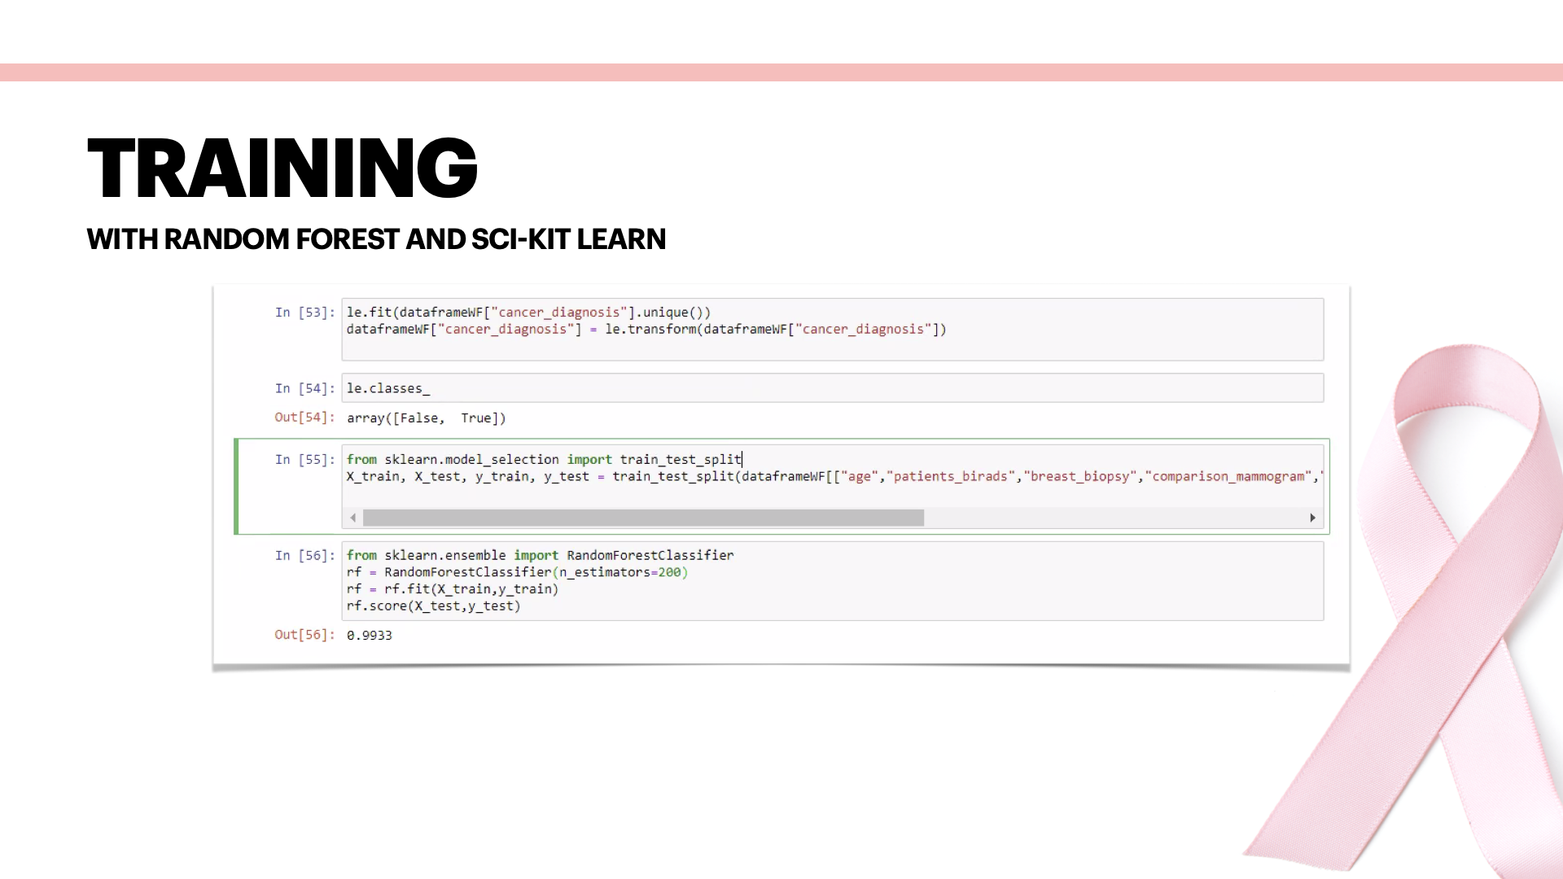

Slide 7
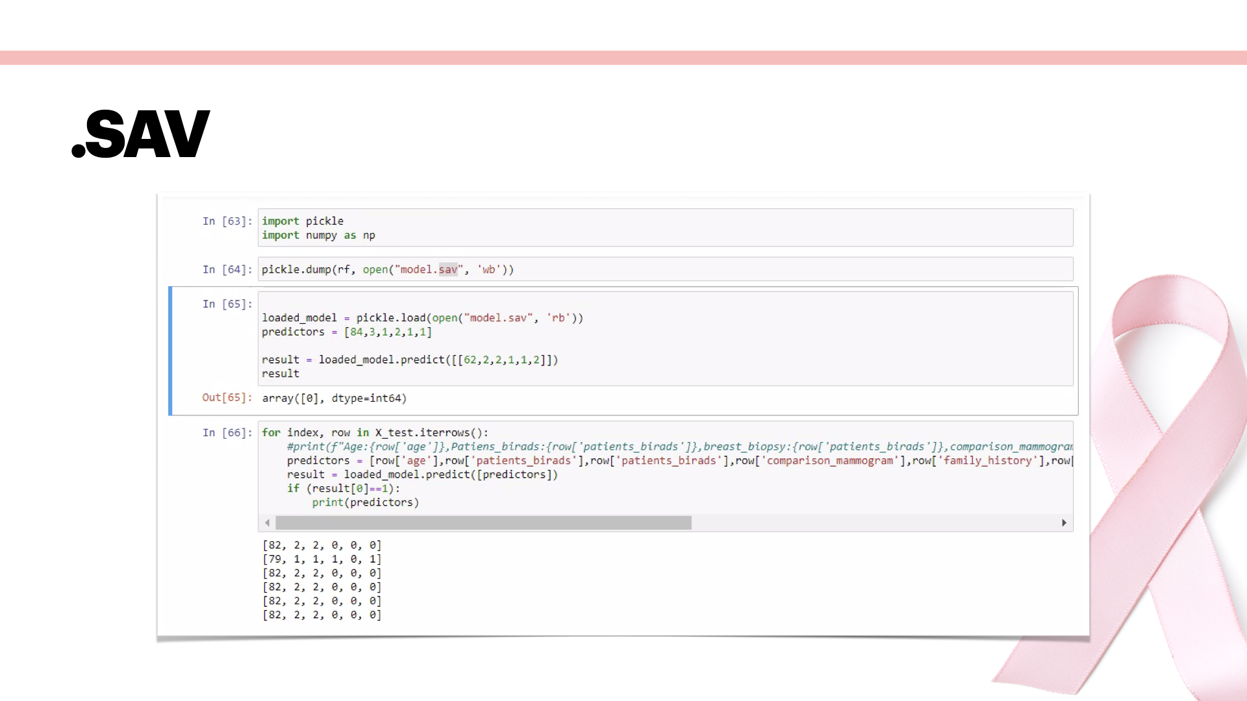

Slide 8
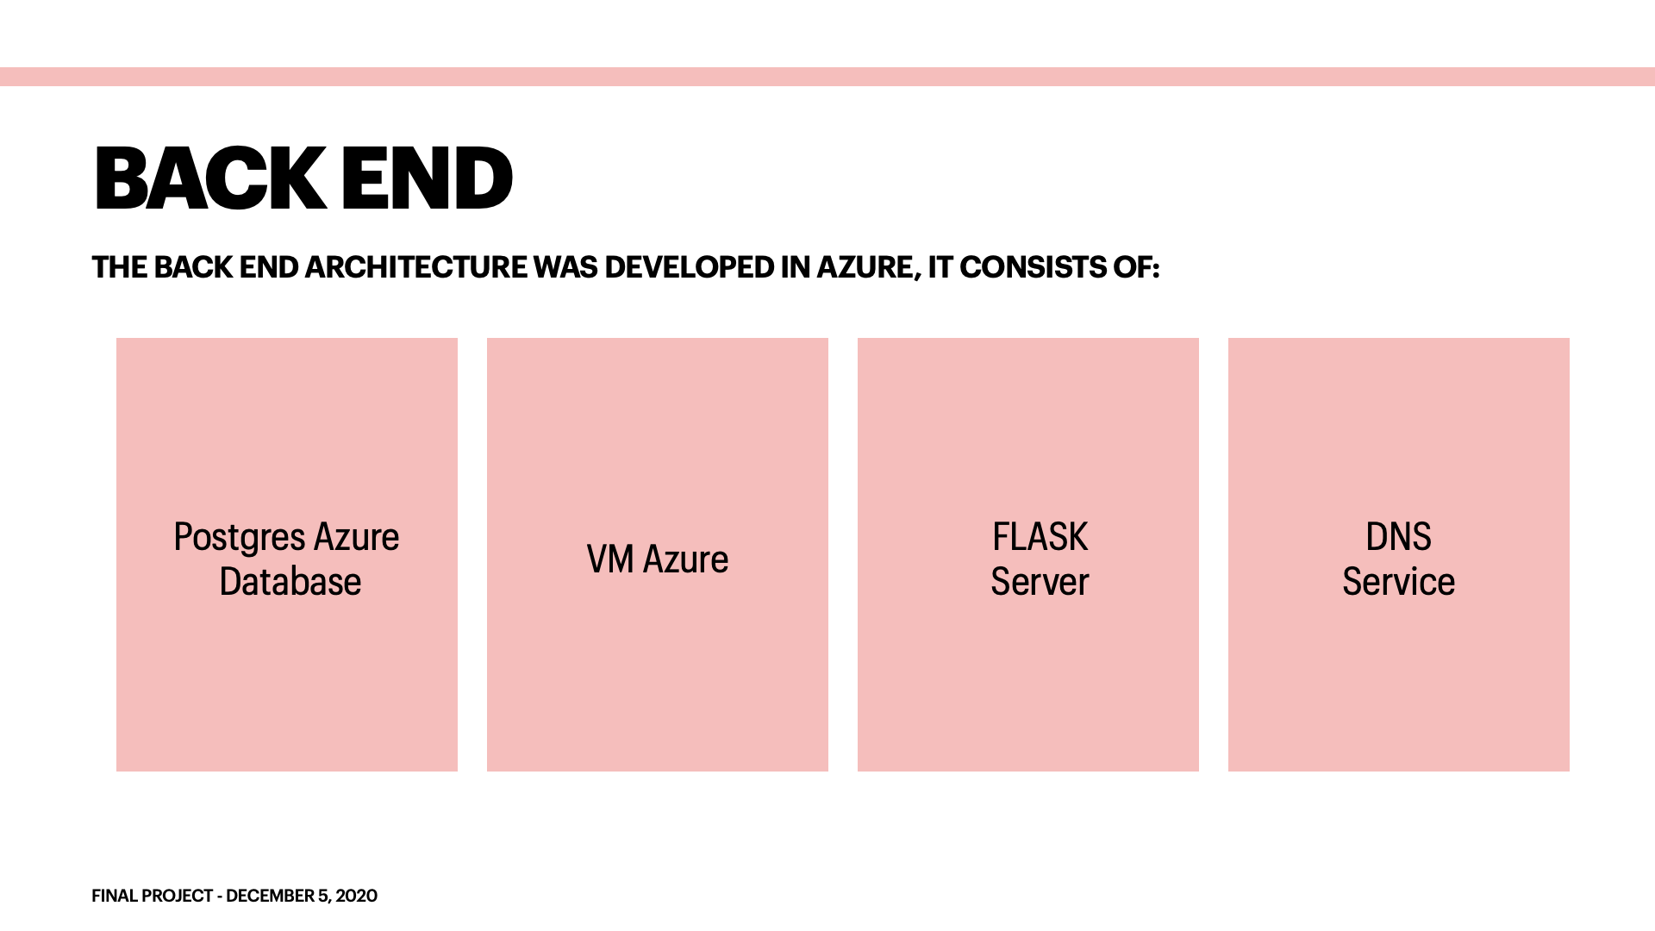
Back End
The back-end architecture was developed in Azure, it consists of:
Postgres Azure database
VM Azure
FLASK Server
DNS Service

Slide 9
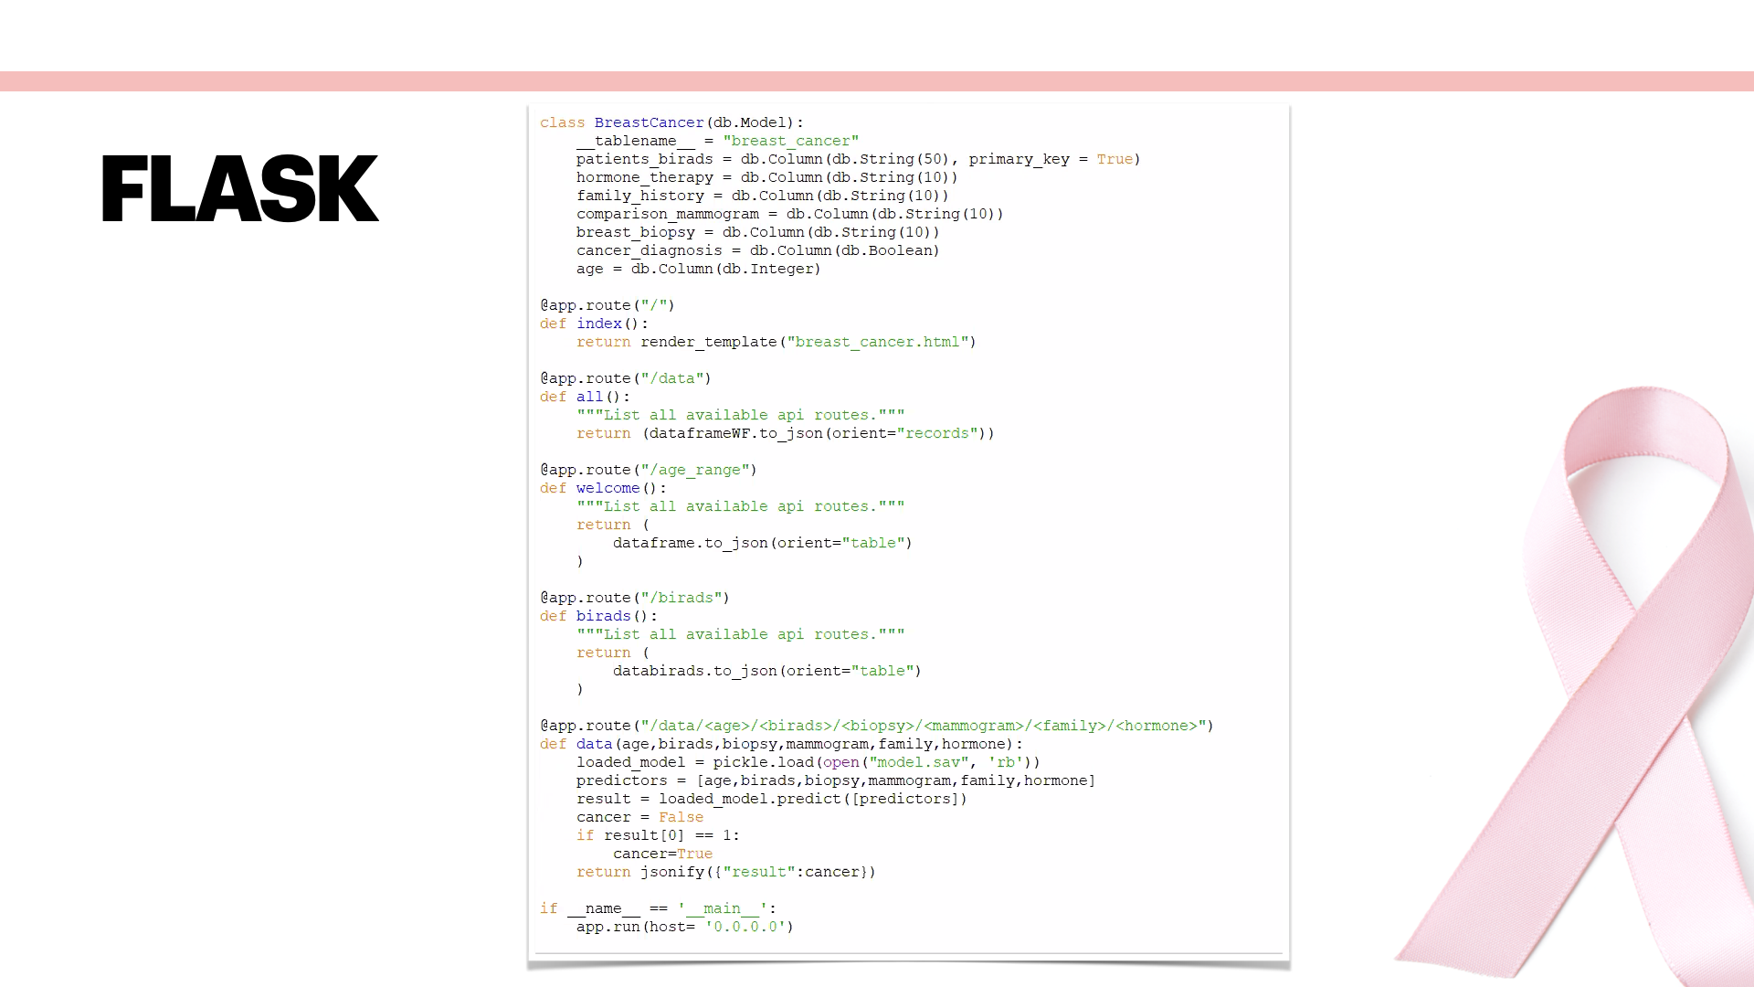

Slide 10
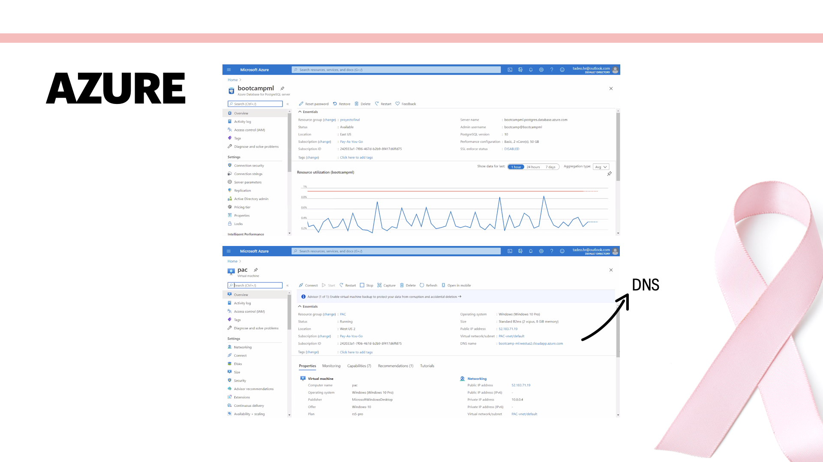

Slide 11
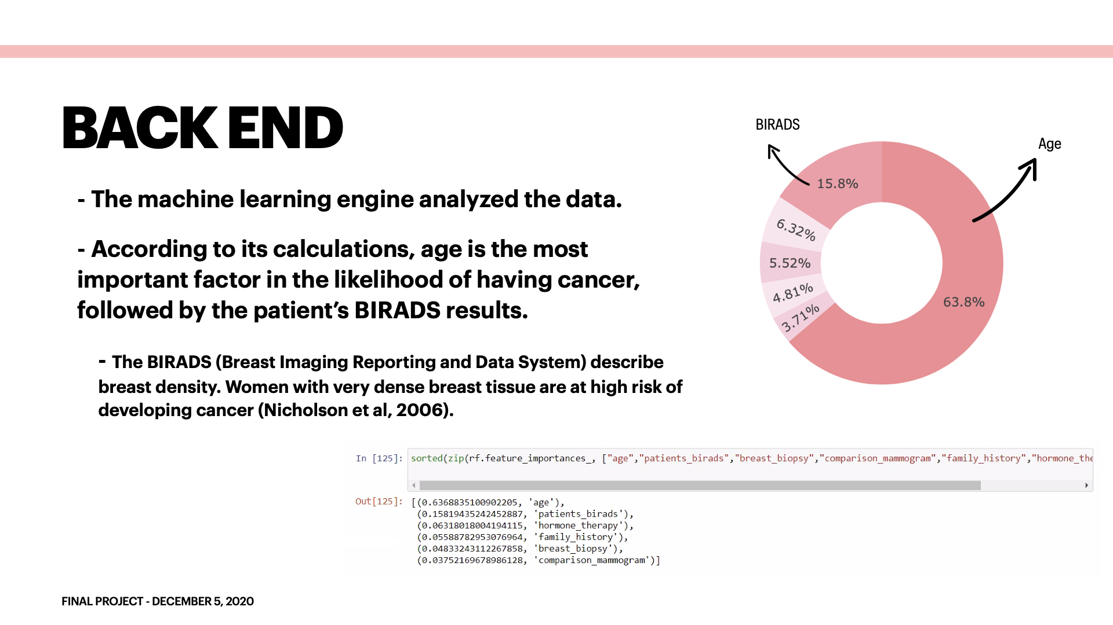

Slide 12
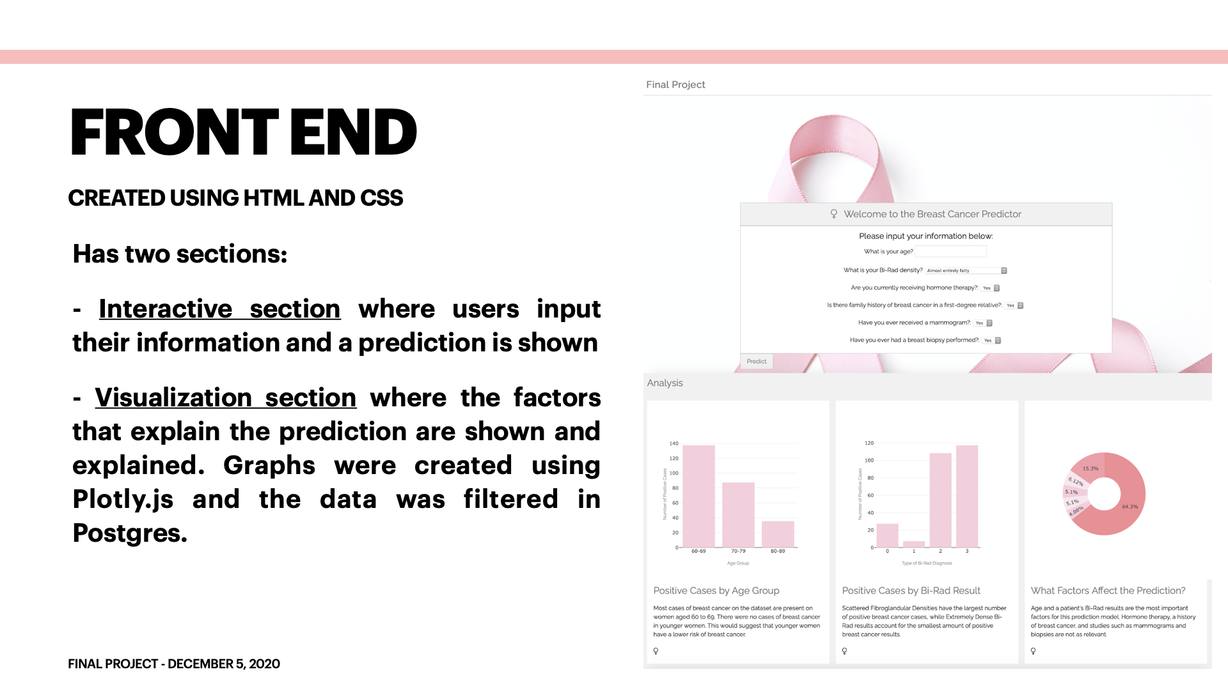

Slide 13
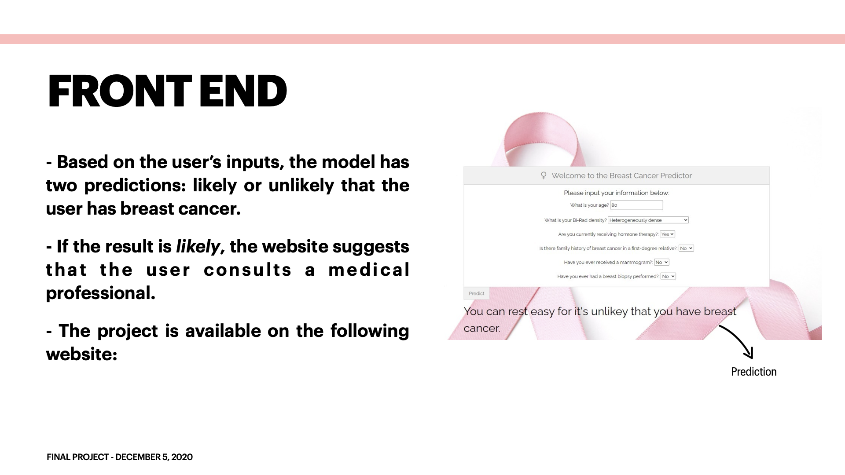
http://bootcamp-ml.westus2.cloudapp.azure.com:5000

Slide 14


